Slide 1
Machine Learning
Lecture 13: Maximum Likelihood Estimation
Dr. Beilun Wang
Southeast University
School of Computer Science
and Engineering

Slide 2
Last: Probability Review
The big picture
Events and Event spaces
Random variables
Joint probability, Marginalization, conditioning, chain rule, Bayes Rule, law of total probability, etc.
Structural properties, e.g., Independence, conditional independence

Slide 3
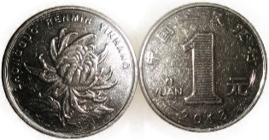
Sample space and Events
Ο: Sample Space,
result of an experiment / set of all outcomes
If you toss a coin twice Ο = {ΗΗ,ΗΤ,ΤΗ,ΤΤ}
Event: a subset of Ο
First toss is head = {HH,HT}
S: Event Space, a set of events:
Contains the empty event and Ο

Slide 4
From Events to Random Variable (RV)
Concise way of specifying attributes of outcomes
Modeling students (Grade and Intelligence):
Ο = all possible students (sample space)
What are events (subset of sample space)
Grade_A = all students with grade A
Grade_B = all students with grade B
HardWorking_Yes = … who works hard
Very cumbersome
Need “functions” that maps from Ο to an attribute space T.
P(H = YES) = P({student ϵ Ο : H(student) = YES})

Slide 5

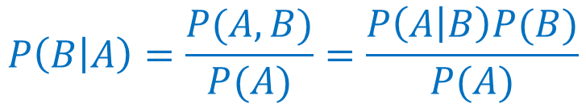
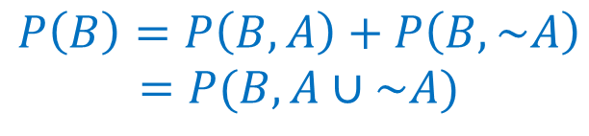
If hard to directly estimate from data, most likely we can estimate
Joint probability
Use Chain Rule
Marginal probability
Use the total law of probability
Conditional probability
Use the Bayes Rule
$$P\left(A,B\right)=P\left(B\right)P\left(A | B\right)$$
$$P\left(B\right)=P\left(B,A\right)+P\left(B,\sim A\right)$$
$$=P(B,A∪\sim A)$$
$$P\left(B | A\right)=\frac{P(A,B)}{P(A)}=\frac{P\left(A | B\right)P(B)}{P(A)}$$

Slide 6
Today
Basic MLE
MLE for Discrete RV
MLE for Continuous RV (Gaussian)
MLE connects to Normal Equation of LR
Extra: Properties about Mean and Variance

Slide 7
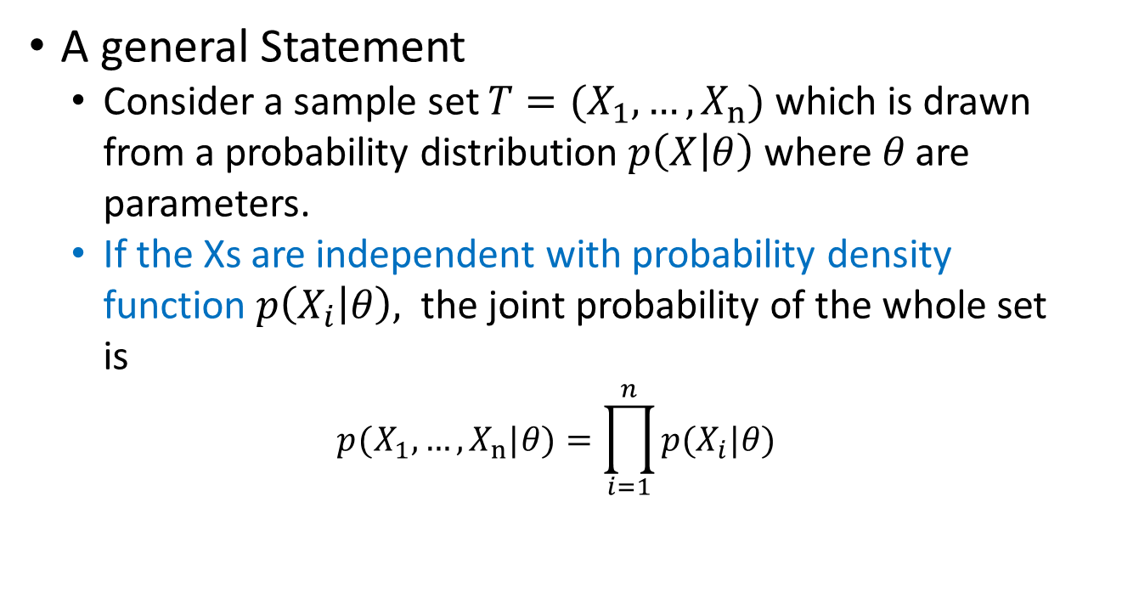
Maximum Likelihood Estimation
A general Statement
Consider a sample set $T=(X_{1},…,X_{n})$which is drawn from a probability distribution $p\left(X | θ\right)$ where 𝜃 are parameters.
If the Xs are independent with probability density function $p\left(X_{i} | θ\right),$ the joint probability of the whole set is
$$p(X_{1},…,X_{n}| θ )=\prod_{i=1}^{n}{p(X_{i}| θ)}$$
this may be maximised with respect to 𝜃 to give the maximum likelihood estimates.

Slide 8
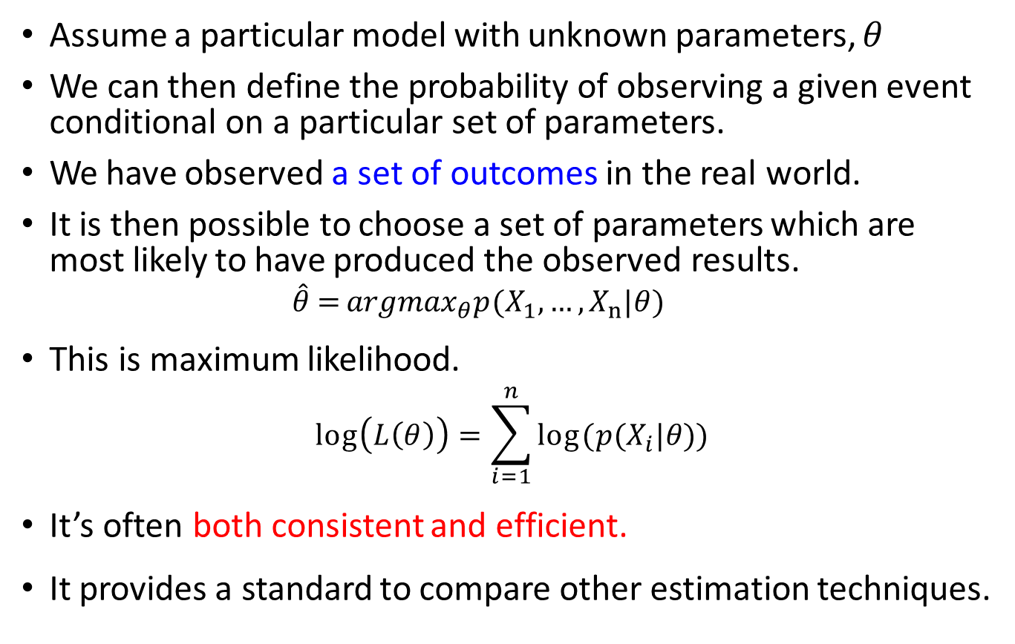
Maximum Likelihood Estimation
Assume a particular model with unknown parameters, $θ$
We can then define the probability of observing a given event conditional on a particular set of parameters.
We have observed a set of outcomes in the real world.
It is then possible to choose a set of parameters which are most likely to have produced the observed results.
$$\hat{θ}={argmax}_{θ} p(X_{1},…,X_{n}| θ )$$
This is maximum likelihood.
$$\log\left(L\left(θ\right)\right)=\sum_{i=1}^{n}{log⁡(p(X_{i}| θ))}$$
It’s often both consistent and efficient.
It provides a standard to compare other estimation techniques.
Likelihood
Log-Likelihood

Slide 9
Today
Basic MLE
MLE for Discrete RV
MLE for Continuous RV (Gaussian)
MLE connects to Normal Equation of LR
Extra: Properties about Mean and Variance

Slide 10
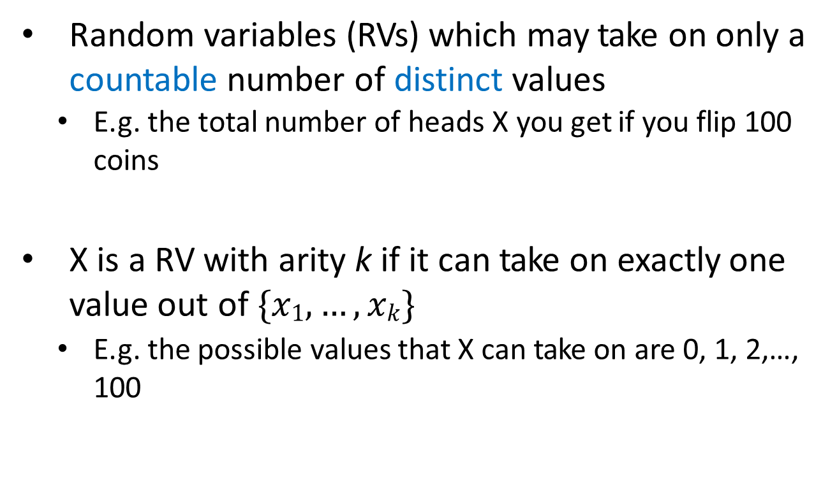
Discrete Random Variables
Random variables (RVs) which may take on only a countable number of distinct values
E.g. the total number of heads X you get if you flip 100 coins
X is a RV with arity k if it can take on exactly one value out of $\{x1, …, xk\}$
E.g. the possible values that X can take on are 0, 1, 2,…, 100

Slide 11

e.g. Coin Flips cont.
You flip a coin
Head with probability p
Binary random variable
Bernoulli trial with success probability p
You flip a coin for k times
How many heads would you expect
Number of heads X is a discrete random variable
Binomial distribution with parameters k and p

Slide 12
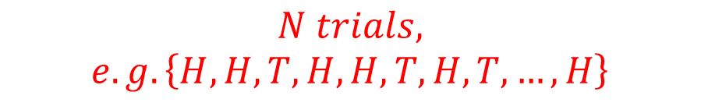

Review: Bernoulli Distribution e.g. Coin Flips
You flip n coins
How many heads would you expect
Head with probability p
Number of heads X out of n trial
Each trial following Bernoulli distribution with parameters p
$$N trials,$$
$$e.g.\left\{H, H, T,H,H,T,H,T, …, H\right\}$$
$$x_{1},x_{2},x_{3},x_{4},x_{5},x_{6},x_{7},x_{8},…,x_{n}$$

Slide 13

Calculating Likelihood
$$Given: \left\{x_{1},x_{2},…,x_{n}, \right\}$$
$$\left\{H,H,T,…,H\right\}$$
$$\left\{1,1,0,…,1\right\}$$
$p\left(x_{i} | θ\right)=p^{x_{i}}{(1−p)}^{1−x_{i}}$, $x_{i}ϵ\left\{0,1\right\}$
reformulate

Slide 14

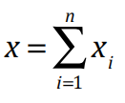

Defining Likelihood for Bernoulli
Likelihood = p(data|parameter)
e.g., for n independent tosses of coins, with unknown parameter p
PMF:
Likelihood:
Observed data ➔ x heads-up from n trials

Slide 15



Deriving the Maximum Likelihood Estimate for Bernoulli
0.08
maximize
likelihood
$$L\left(p\right)=p^{x}{(1−p)}^{n−x}$$
0.04
0.00
maximize
!50 0
log(likelihood)
$$\log\left(L\left(p\right)\right)=log⁡[p^{x}{(1−p)}^{n−x}]$$
!150
!250
minimize the negative log-likelihood
-log(likelihood)
200
$$−l\left(p\right)=−log⁡[p^{x}{(1−p)}^{n−x}]$$
0 50 100

Slide 16
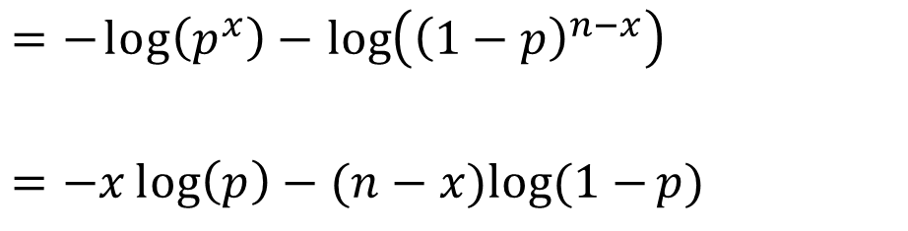
Deriving the Maximum Likelihood Estimate for Bernoulli
minimize the negative log-likelihood
$$\underset{p}{argmin}\left\{−l(p)\right\}=−\log\left(L\left(p\right)\right)=−log⁡[p^{x}{(1−p)}^{n−x}]$$
$$=−\log\left(p^{x}\right)−\log\left({\left(1−p\right)}^{n−x}\right)$$
$$=−x\log\left(p\right)−(n−x)log⁡(1−p)$$

Slide 17
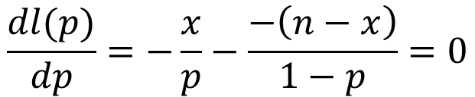
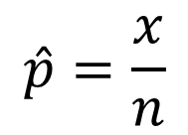

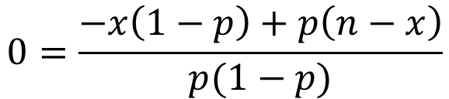
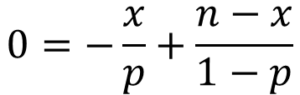
Deriving the Maximum Likelihood Estimate for Bernoulli
$$\underset{p}{argmin}\left\{−l(p)\right\}=\underset{p}{argmin}\left\{−x log⁡(p)−\left(n−x\right)log(1−p)\right\}$$
$$\frac{dl(p)}{dp}=−\frac{x}{p}−\frac{−\left(n−x\right)}{1−p}=0$$
➔ MLE parameter estimation
$$0=−\frac{x}{p}+\frac{n−x}{1−p}$$
$$\hat{p}=\frac{x}{n}$$
$$0=\frac{−x\left(1−p\right)+p\left(n−x\right)}{p(1−p)}$$
i.e. Relative frequency of a binary event
$$0=−x+px+pn−px$$

Slide 18
Today
Basic MLE
MLE for Discrete RV
MLE for Continuous RV (Gaussian)
MLE connects to Normal Equation of LR
Extra: Properties about Mean and Variance

Slide 19
Review: Continuous Random Variables
Probability density function (PDF) instead of probability mass function (PMF)
For discrete RV: Probability mass function (PMF): P(X = x_{i})
A PDF (prob. Density func.) is any function f(x) that describes the probability density in terms of the input variable x.

Slide 20
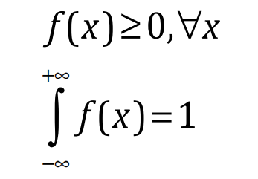
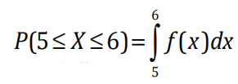
Review: Probability of Continuous RV
Properties of PDF
Actual probability can be obtained by taking the integral of PDF
E.g. the probability of X being between 5 and 6 is

Slide 21
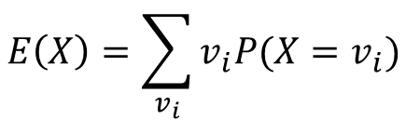

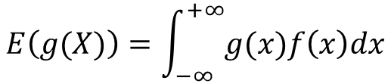
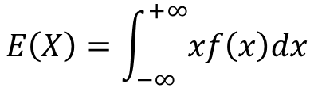
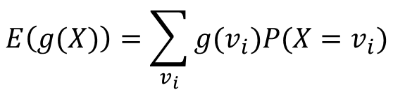
Review: Mean and Variance of RV
Mean (Expectation):
Discrete RVs:
Continuous RVs:
$$μ=E(X)$$
$$E\left(X\right)=\sum_{v_{i}}{v_{i}P(X=v_{i})}$$
$$E\left(g(X)\right)=\sum_{v_{i}}{{g(v}_{i})P(X=v_{i})}$$
$$E\left(X\right)=\int_{−∞}^{+∞}{xf\left(x\right)dx}$$
$$E\left(g(X)\right)=\int_{−∞}^{+∞}{g(x)f\left(x\right)dx}$$

Slide 22
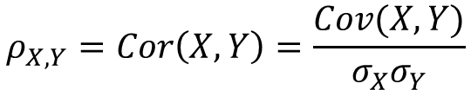

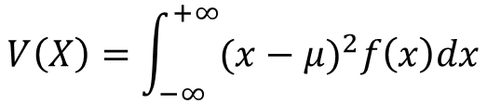
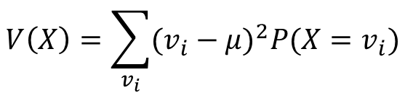
Review: Mean and Variance of RV
Variance:
Discrete RVs:
Continuous RVs:
Correlation:
Covariance:
$$Var\left(X\right)=E((X−μ)^{2})$$
$$V\left(X\right)=\sum_{v_{i}}{(v_{i}−μ)^{2}P(X=v_{i})}$$
$$V\left(X\right)=\int_{−∞}^{+∞}{(x−μ)^{2}f\left(x\right)dx}$$
$$ρ_{X,Y}=Cor\left(X,Y\right)=\frac{Cov(X,Y)}{σ_{X}σ_{Y}}$$
$$Cov\left(X,Y\right)=E\left(\left(X−μ_{x}\right)\left(Y−μ_{y}\right)\right)=E\left(XY\right)−μ_{x}μ_{y}$$

Slide 23
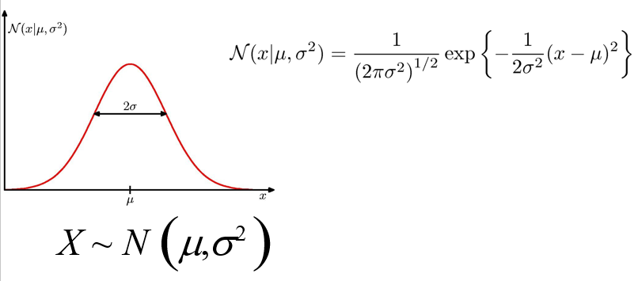

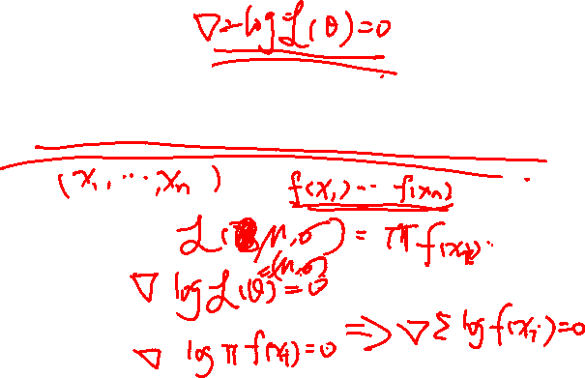
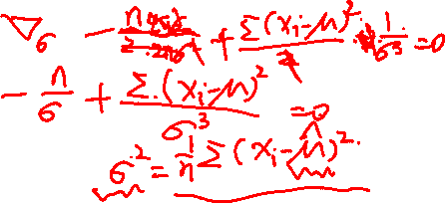
Single-Variate Gaussian Distribution

Slide 24
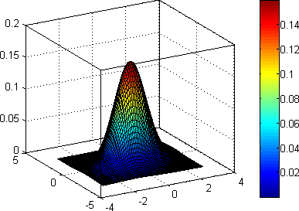
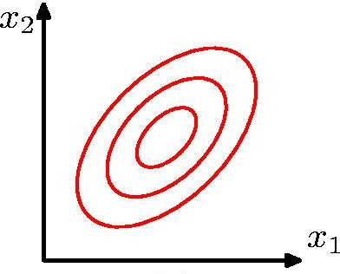
Bi-Variate Gaussian Distribution
Bivariate normal PDF
Mean of normal PDF is at peak value. Contours of equal PDF form ellipses.
The covariance matrix captures linear dependencies among the variables

Slide 25

Multivariate Normal (Gaussian) PDFs
The only widely used continuous joint PDF is the multivariate normal (or Gaussian):
Mean
Covariance Matrix
Mean of normal PDF is at peak value. Contours of equal PDF form ellipses.
The covariance matrix captures linear dependencies among the variables

Slide 26
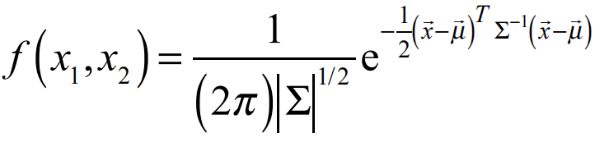
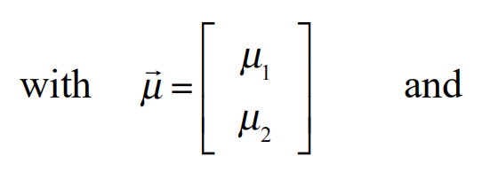
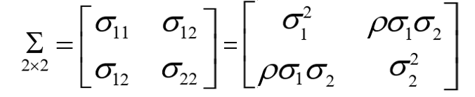

Example: the Bivariate Normal distribution
2×2
11

Slide 27
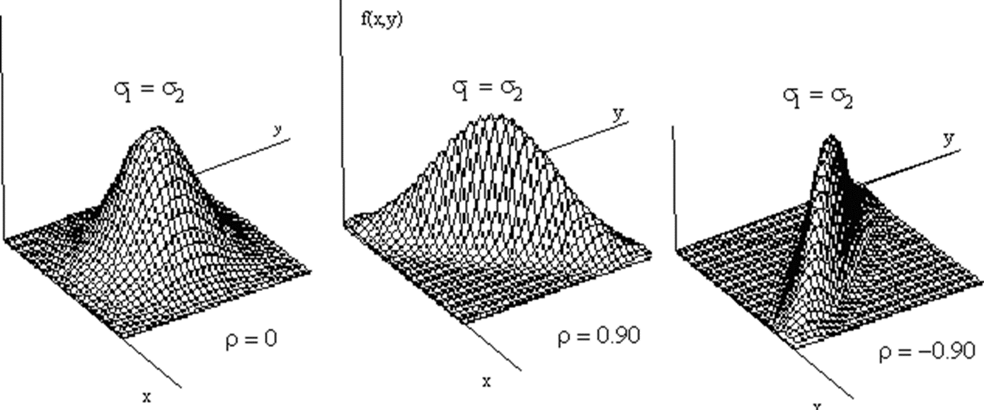
Surface Plots of the bivariate Normal distribution

Slide 28
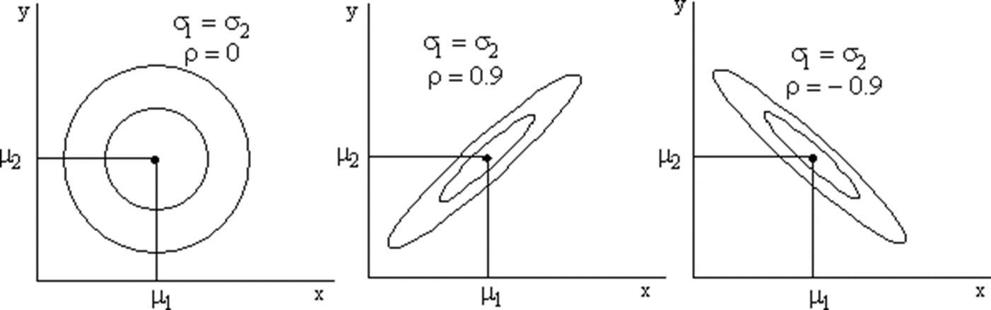
Contour Plots of the bivariate Normal distribution

Slide 29
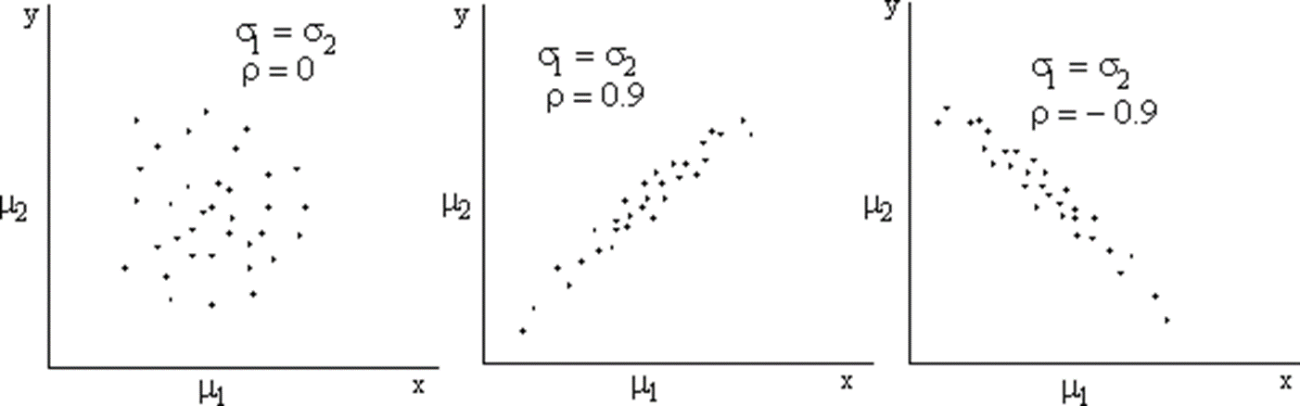
Scatter Plots of the bivariate Normal distribution

Slide 30
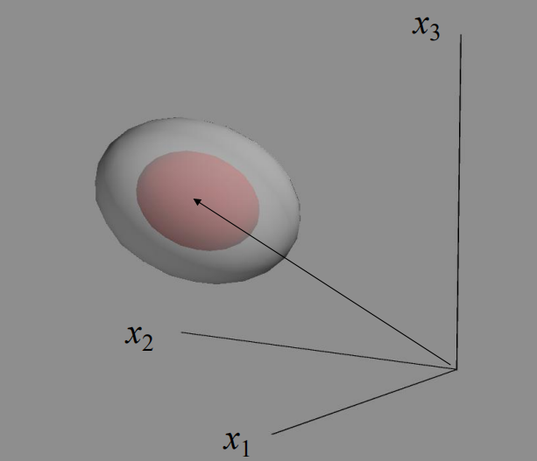
Trivariate Normal distribution

Slide 31
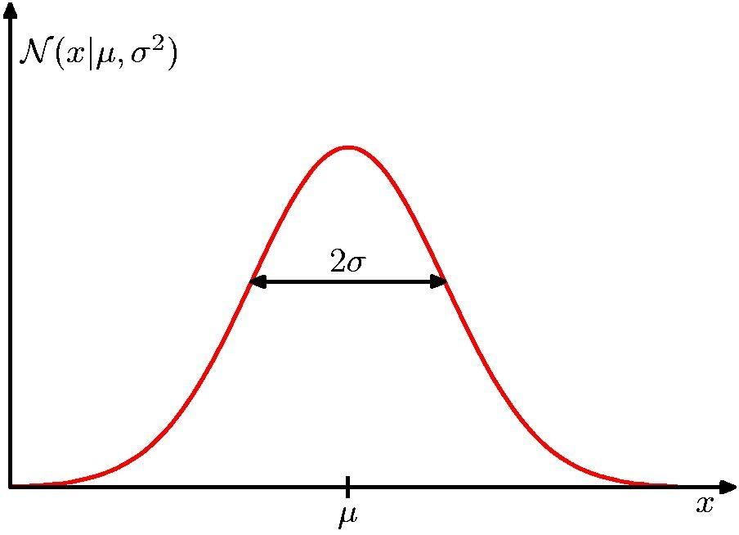


Use MLE to estimate 1-D Gaussian
In the 1D Gaussian case, we simply set the mean and the variance to the sample mean and the sample variance:
$$\overline{μ}=\frac{1}{n}\sum_{i=1}^{n}{x_{i}}$$
$$\overline{σ^{2}}=\frac{1}{n}\sum_{i=1}^{n}{(x_{i}−\overline{μ})^{2}}$$

Slide 32
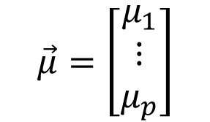
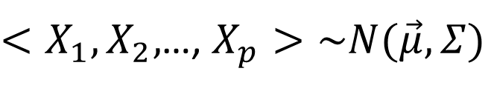
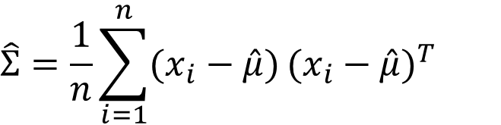
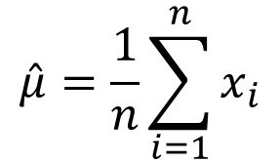
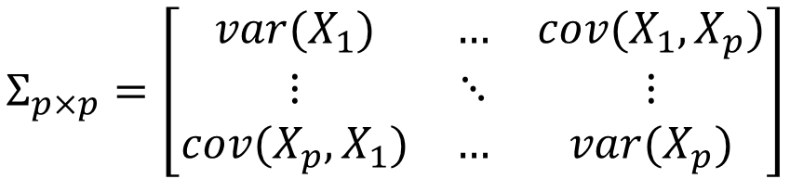
Use MLE to estimate p-D Gaussian
$<X_{1},X_{2},$…, $X_{p}>\sim N(\vec{μ},Σ)$
$$\vec{μ}=\left[\begin{matrix}μ_{1} \\ ⋮ \\ μ_{p}\end{matrix}\right]$$
$$Σ_{p×p}=\left[\begin{matrix}var(X_{1}) & … & cov(X_{1},X_{p}) \\ ⋮ & ⋱ & ⋮ \\ cov(X_{p},X_{1}) & … & var(X_{p})\end{matrix}\right]$$
$$\hat{μ}=\frac{1}{n}\sum_{i=1}^{n}{x_{i}}$$
$$\hat{Σ}=\frac{1}{n}\sum_{i=1}^{n}{(x_{i}−\hat{μ})}{(x_{i}−\hat{μ})}^{T}$$

Slide 33
Today
Basic MLE
MLE for Discrete RV
MLE for Continuous RV (Gaussian)
MLE connects to Normal Equation of LR
Extra: Properties about Mean and Variance

Slide 34

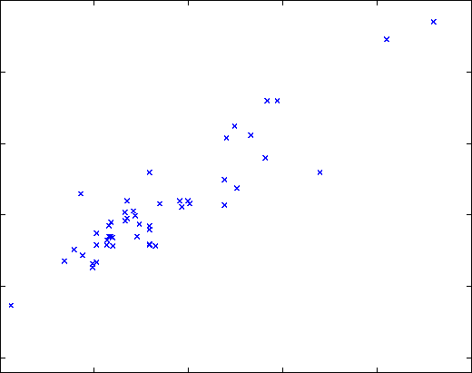
DETOUR: Probabilistic Interpretation of Linear Regression
Let us assume that the target variable and the inputs are related by the equation:
where ε is an error term of unmodeled effects or random noise

Slide 35
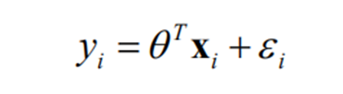
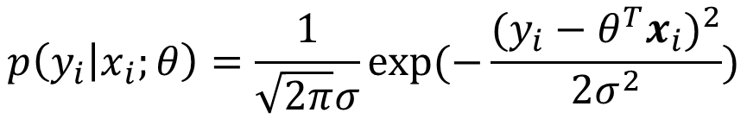
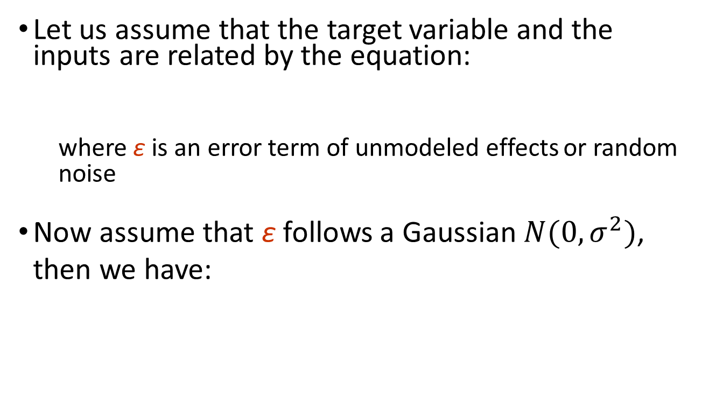
DETOUR: Probabilistic Interpretation of Linear Regression
Let us assume that the target variable and the inputs are related by the equation:
where ε is an error term of unmodeled effects or random noise
Now assume that ε follows a Gaussian $N(0,σ^{2})$, then we have:
$$p\left(y_{i} | x_{i};θ\right)=\frac{1}{\sqrt{2π}σ}exp⁡(−\frac{{(y_{i}−θ^{T}x_{i})}^{2}}{2σ^{2}})$$

Slide 36
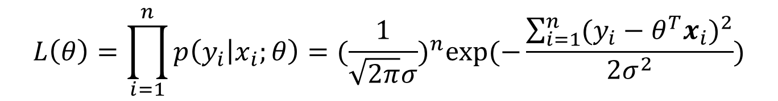

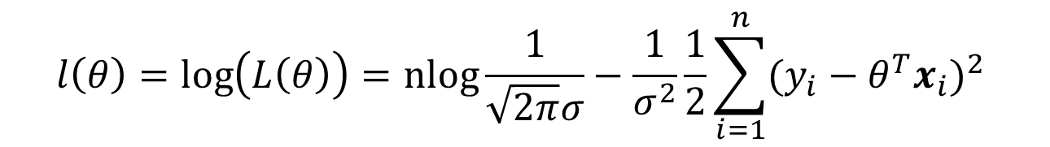
DETOUR: Probabilistic Interpretation of Linear Regression
By IID (independent and identically distributed) assumption, we have data likelihood
We can learn $θ$ by maximizing the likelihood of generating the observed samples
$$L\left(θ\right)=\prod_{i=1}^{n}{p\left(y_{i} | x_{i};θ\right)={(\frac{1}{\sqrt{2π}σ})}^{n}exp⁡(−\frac{\sum_{i=1}^{n}{(y_{i}−θ^{T}x_{i})^{2}}}{2σ^{2}})}$$
$$l\left(θ\right)=\log\left(L\left(θ\right)\right)=\operatorname{nlog}{\frac{1}{\sqrt{2π}σ}}−\frac{1}{σ^{2}}\frac{1}{2}\sum_{i=1}^{n}{(y_{i}−θ^{T}x_{i})^{2} }$$

Slide 37




MLE connects to Normal Equation of LR
Thus under independence Gaussian residual assumption, residual square error is equivalent to MLE of $θ$ !
$$l\left(θ\right)=\log\left(L\left(θ\right)\right)=\operatorname{nlog}{\frac{1}{\sqrt{2π}σ}}−\frac{1}{σ^{2}}\frac{1}{2}\sum_{i=1}^{n}{(y_{i}−θ^{T}x_{i})^{2} }$$
$$argmaxl(θ)⇒argminJ(θ)$$
$$J\left(θ\right)=\frac{1}{2}\sum_{i=1}^{n}{{(x_{i}^{T}θ−y_{i})}^{2}}$$

Slide 38
References
https://qiyanjun.github.io/2019f-UVA-CS6316-MachineLearning/
Prof. Andrew Moore’s review tutorial
Prof. Nando de Freitas’s review slides
Prof. Carlos Guestrin recitation slides

Slide 39
Today
Basic MLE
MLE for Discrete RV
MLE for Continuous RV (Gaussian)
MLE connects to Normal Equation of LR
Extra: Properties about Mean and Variance

Slide 40
Properties
Correlation:
ρ (X,Y ) = Cov (X,Y ) /σ _{x}σ _{y}
−1 ≤ ρ (X,Y ) ≤ 1

Slide 41

Properties
Mean
$$E\left(X+Y\right)=E\left(X\right)+E\left(Y\right)$$
$$E\left(aX\right)=aE(X)$$
If X and Y are independent,
$$E\left(XY\right)=E\left(X\right)E\left(Y\right)$$
Variance
$$V\left(aX+b\right)\text{=}a^{2}V(X)$$
If X and Y are independent,
$$V\left(X+Y\right)=V\left(X\right)+V\left(Y\right)$$

Slide 42

Properties
The conditional expectation of Y given X when the value of X = x is:
$$E\left(Y | X=x\right)=\int{y∗p(y | x)dy }$$
The Law of Total Expectation / Law of Iterated Expectation:
$$E\left(Y\right)=E\left[E\left(Y | X\right)\right]=\int{E\left(Y | X=x\right)p_{x}\left(x\right)dx}$$
The law of Total Variance:
$$Var\left(Y \right)=Var[E (Y|X )]+E[Var(Y|X )]$$

Slide 43
Thanks for listening

